Slide 1
Fast Fourier Transform and
Application on Major US cities’ Temperature Data
Yuting Ji & Scott Winters

Slide 2
The algorithm

Slide 3
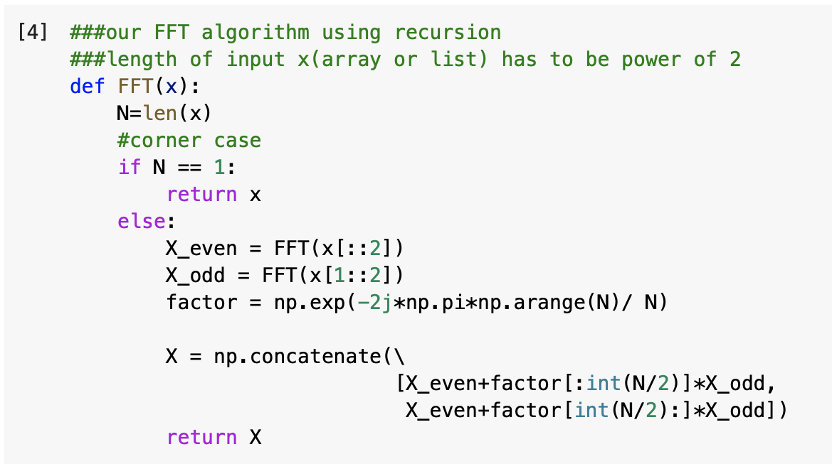

Slide 4


Comparison with Numpy FFT

Slide 5


Slide 6



Slide 7


Slide 8
Runtime of FFT

Slide 9
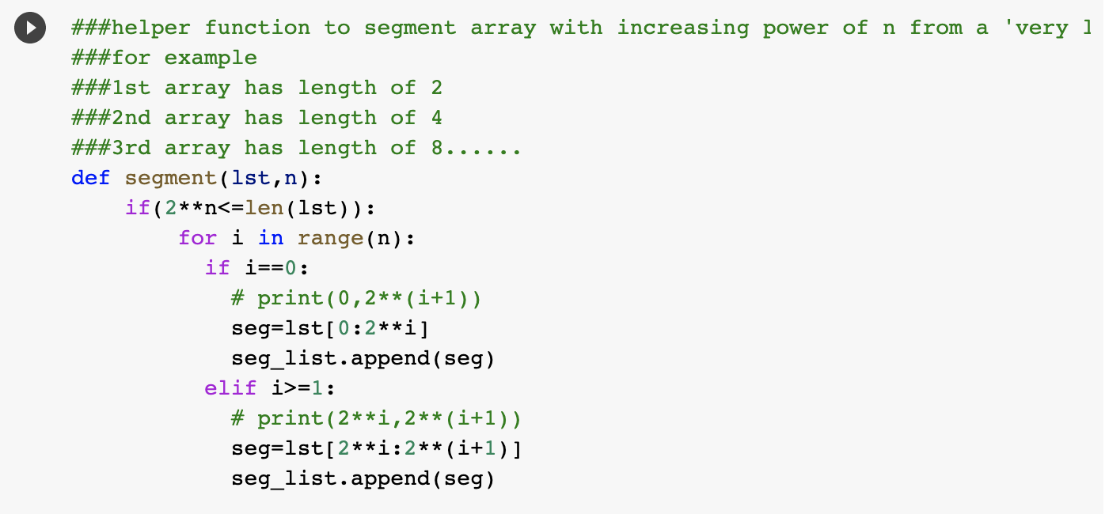
Generate a random, long array and take segments from it

Slide 10

Use time package to record runtime for each segmented array

Slide 11
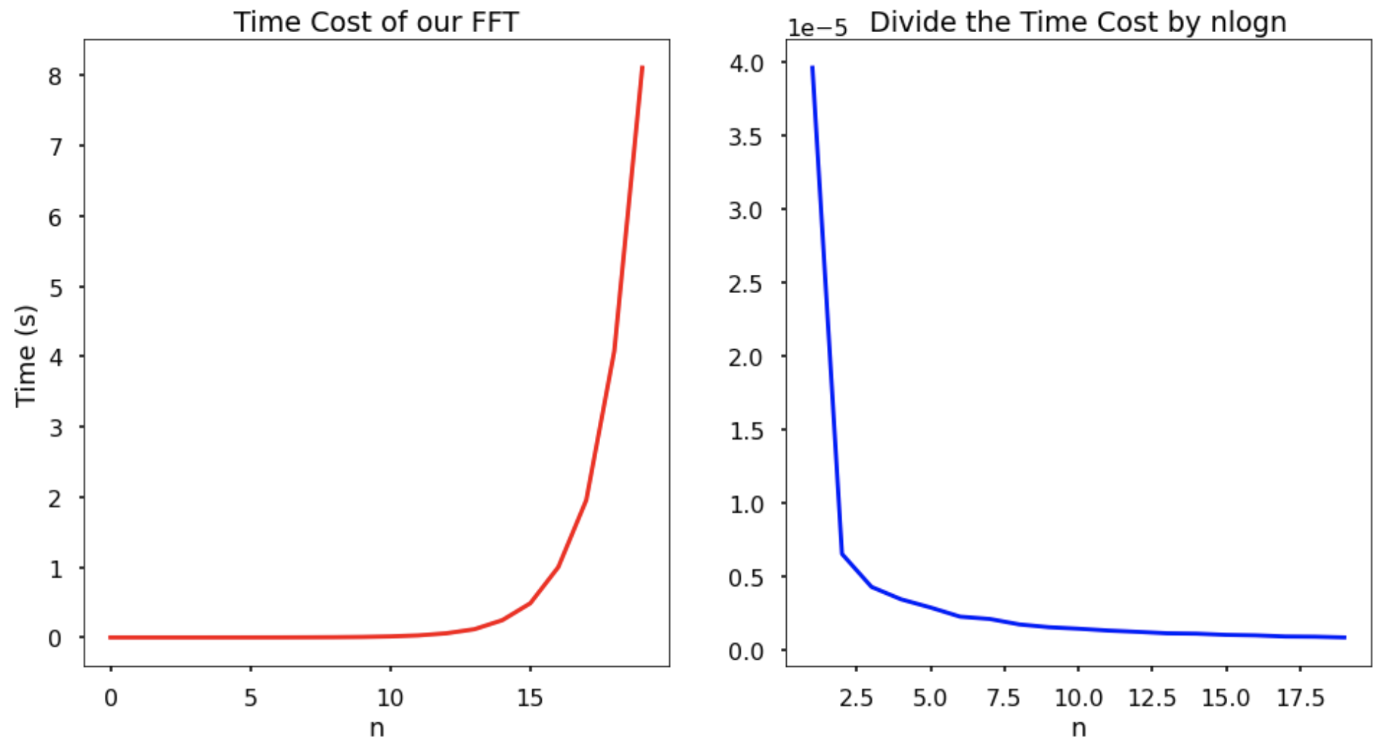

Slide 12
Apply FFT to real-world data

Slide 13
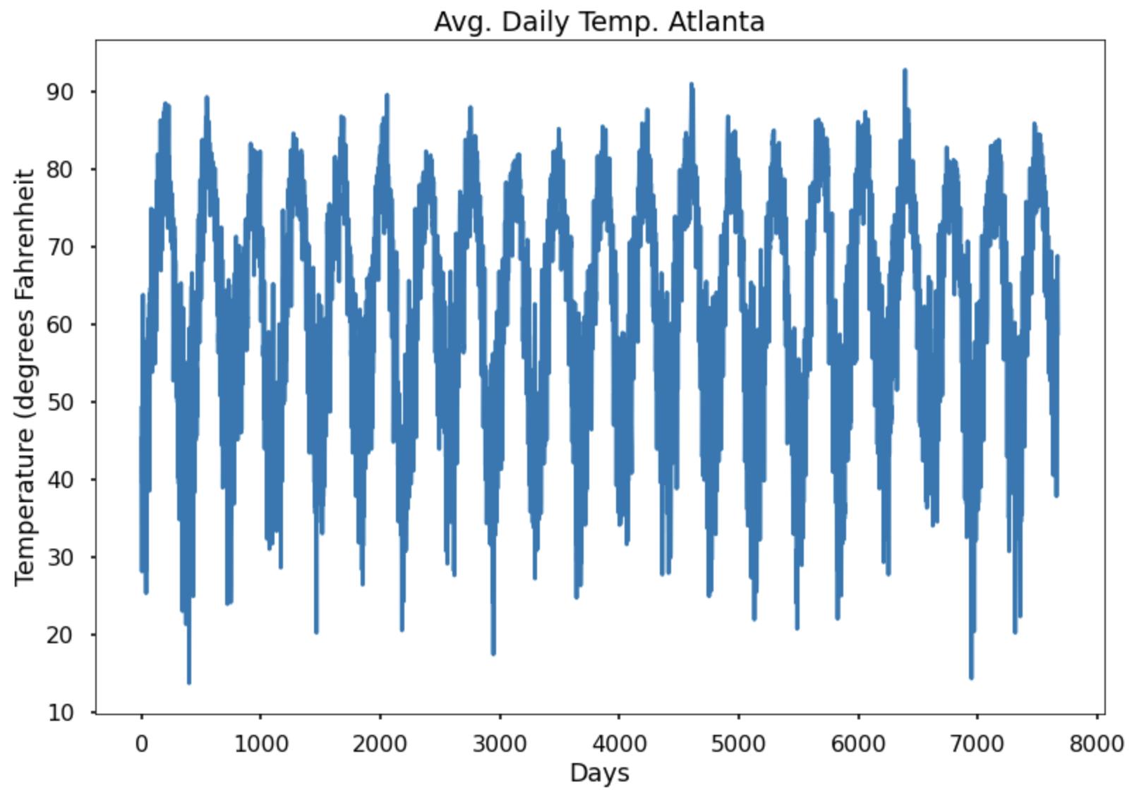

Slide 14
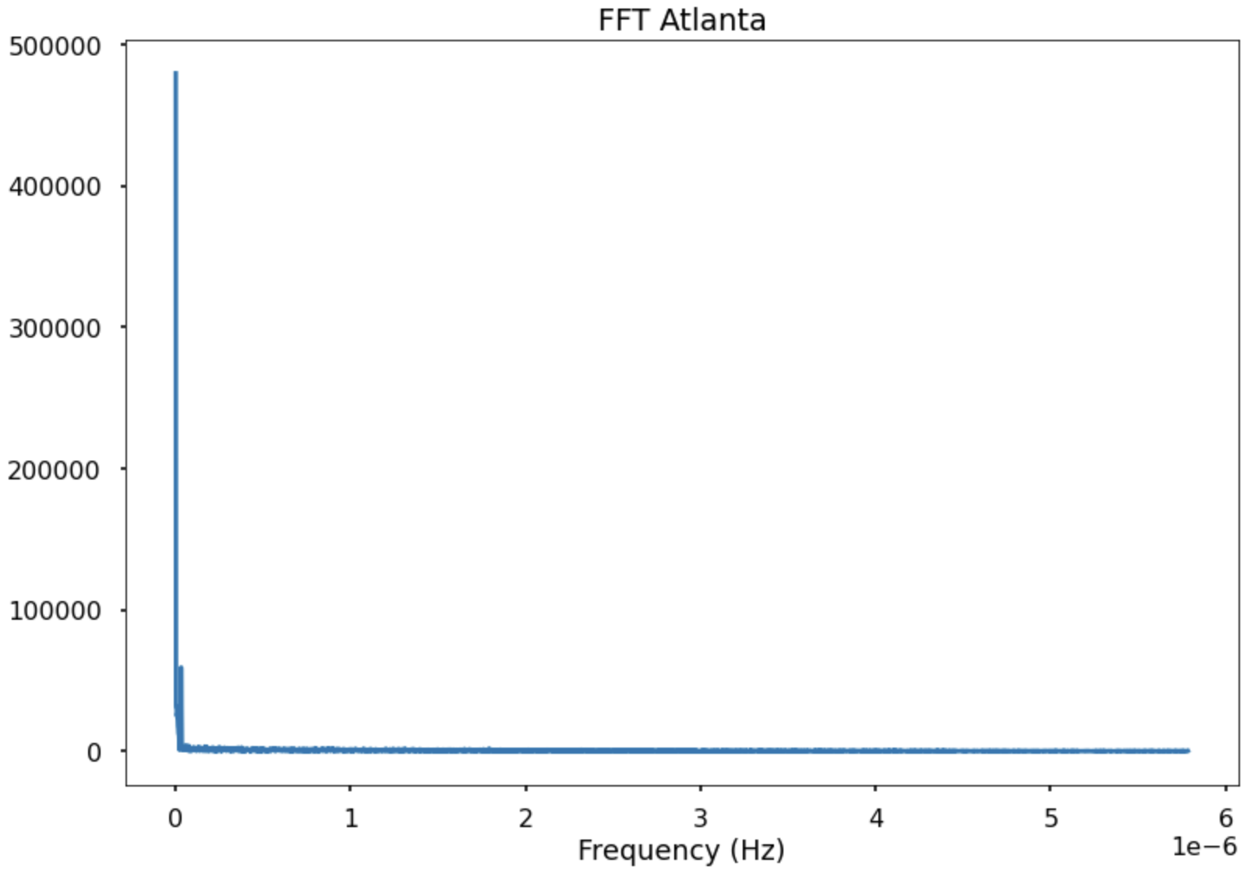

Slide 15
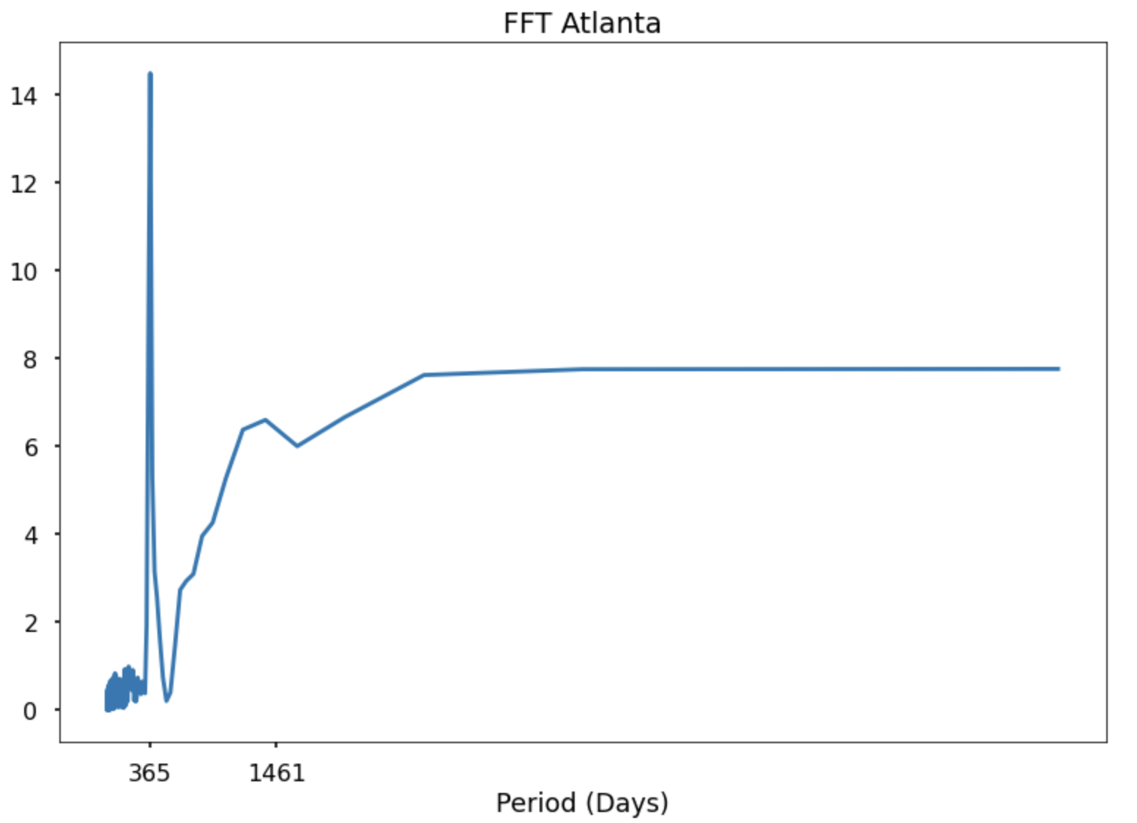

Slide 16
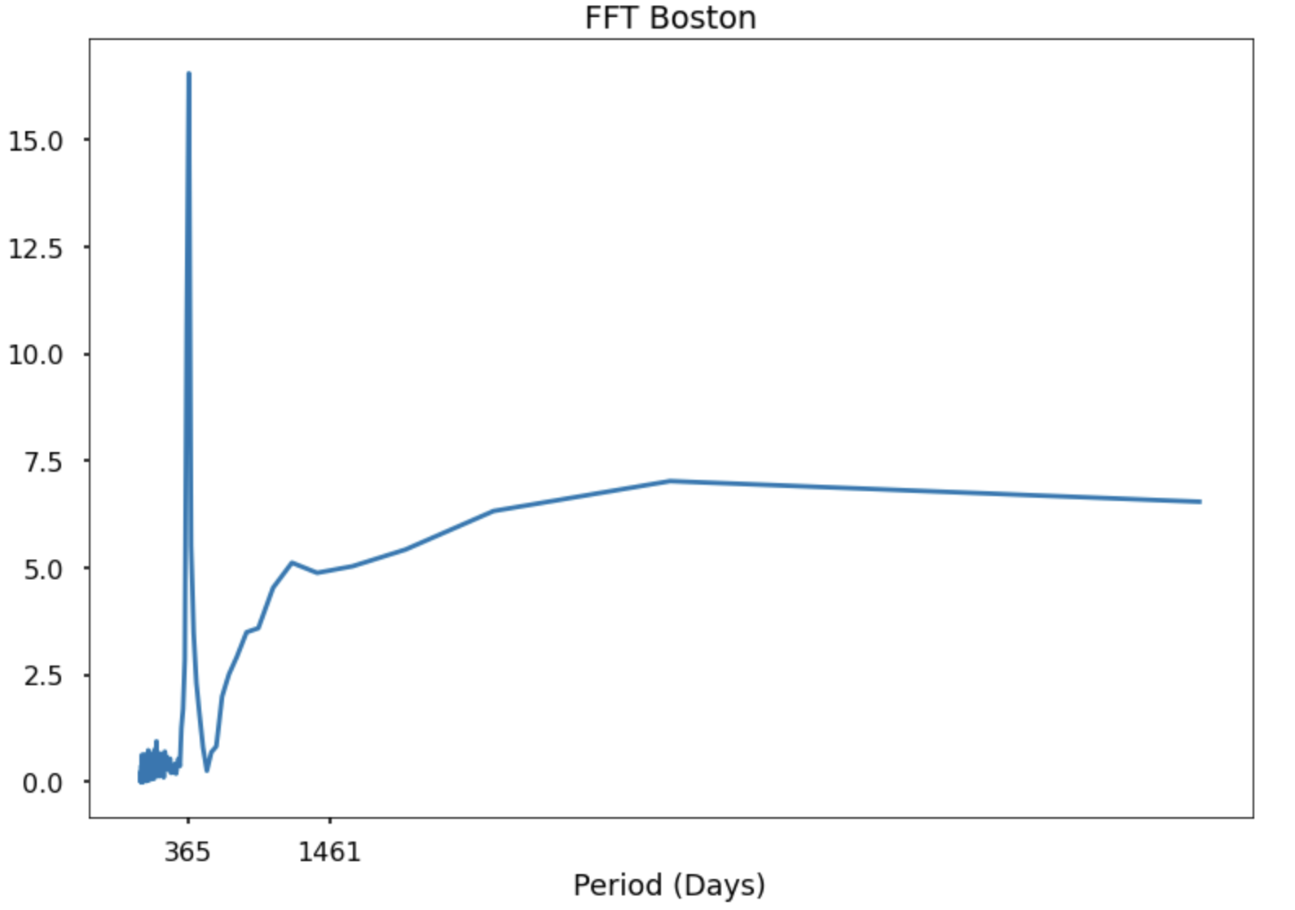

Slide 17
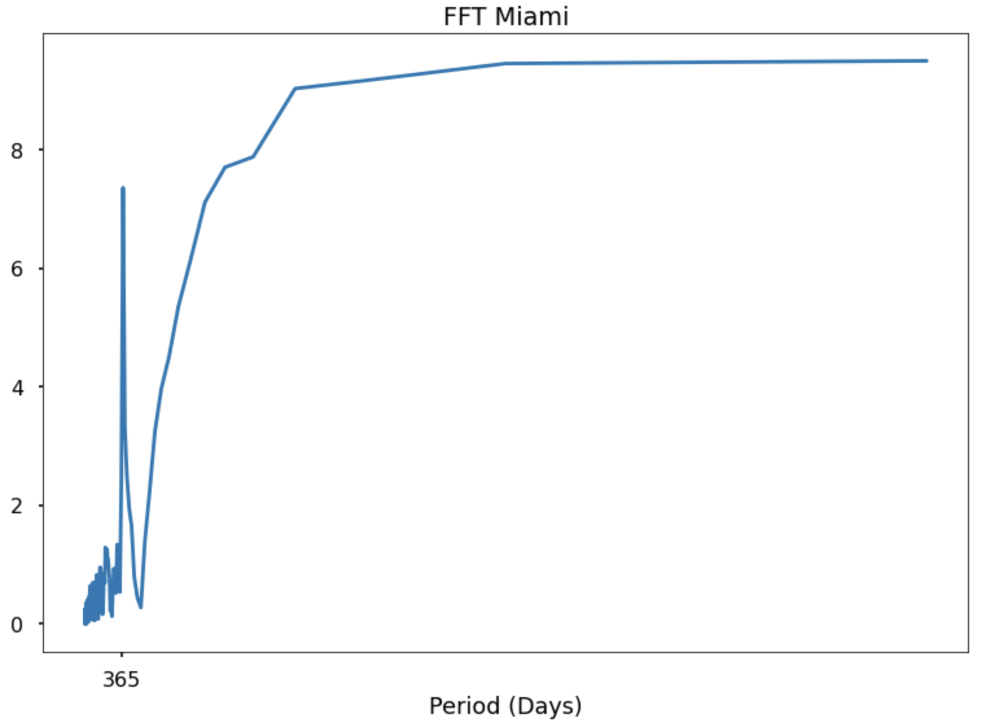

Slide 18
